Slide 1
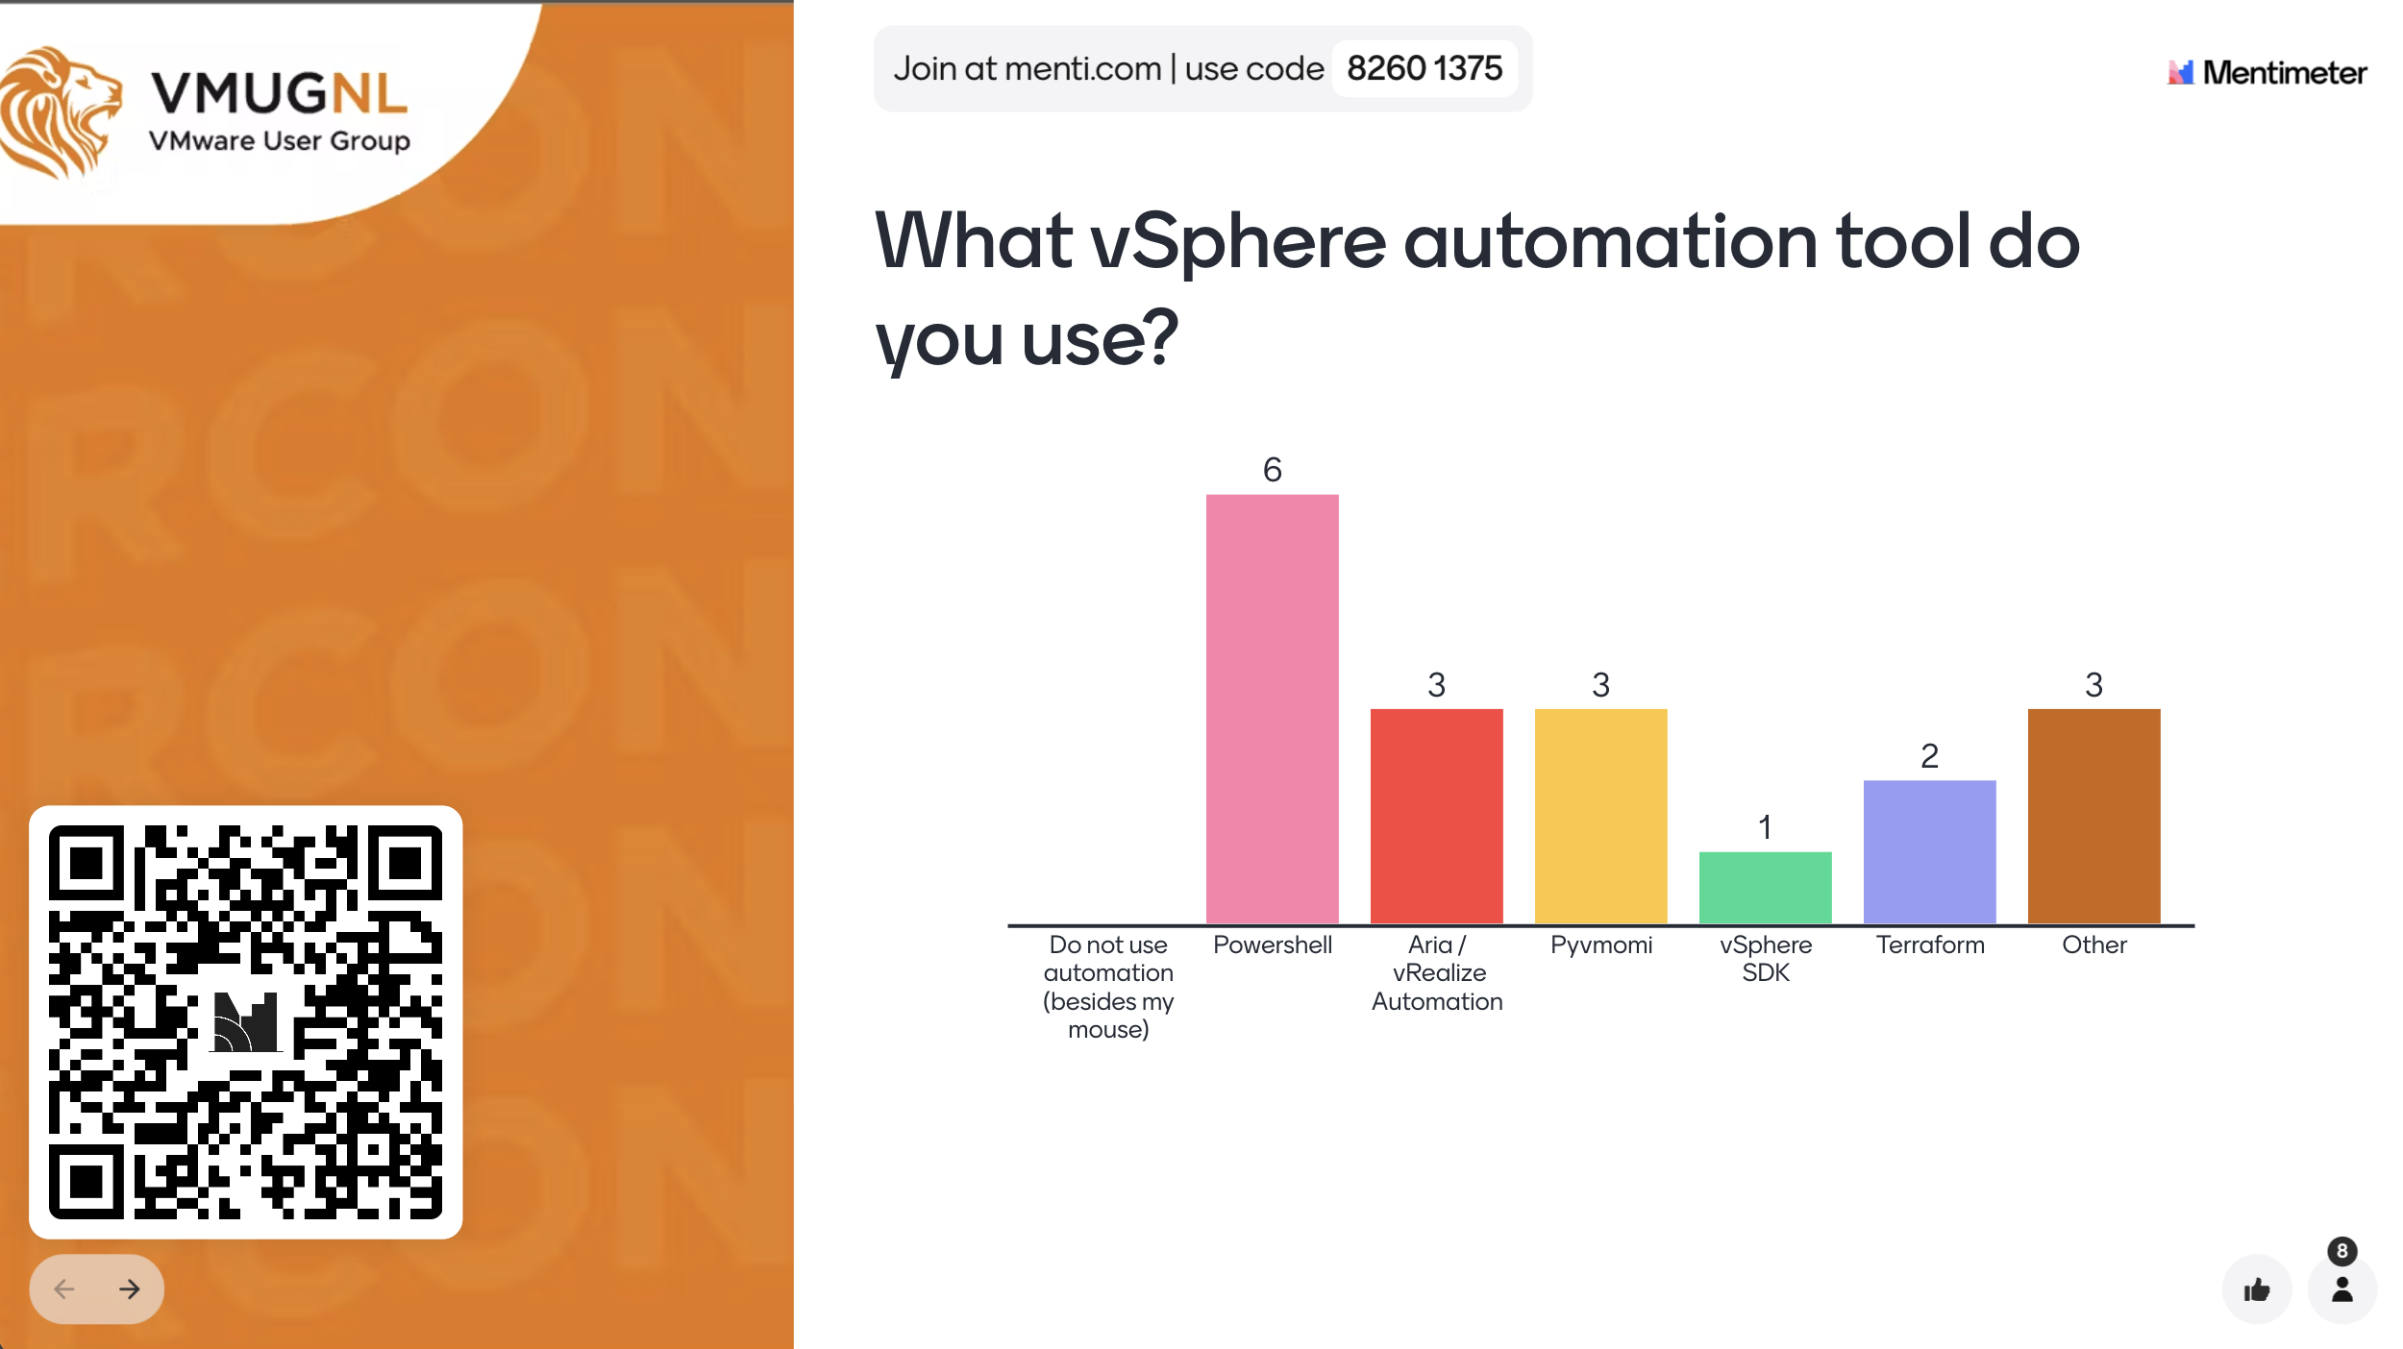

Slide 2
Revolutionizing Automation: Unleashing Cloud Power on Your VMware Realm
Richard Garsthagen
Oracle Cloud VMware Solution Specialist
VMware Enthusiast

Slide 3
Automation options
VMware by Broadcom
vRealize/Aria Automation
Pyvmomi
Powershell PowerCLI
vSphere SDK

Slide 4
Automation options
VMware by Broadcom
vRealize/Aria Automation
Pyvmomi
Powershell PowerCLI
vSphere SDK
Open “cloud” standards
terraform
ansible
Cloud-init
steampipe

Slide 5
Automation options
VMware by Broadcom
vRealize/Aria Automation
Pyvmomi
Powershell PowerCLI
vSphere SDK
Open “cloud” standards
terraform
ansible
Cloud-init
steampipe
No judgement, all are great ☺

Slide 6
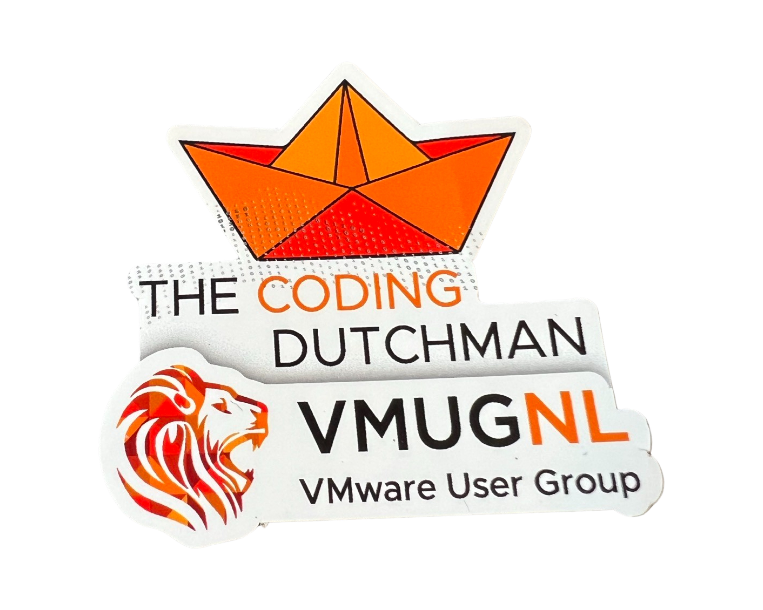
Infrastructure as code RULEZZZ
Infrastructure as code is great because:
Can be managed as code; version control, automated code validation, reviewer, full history, easy roll back, repeatable

Slide 7
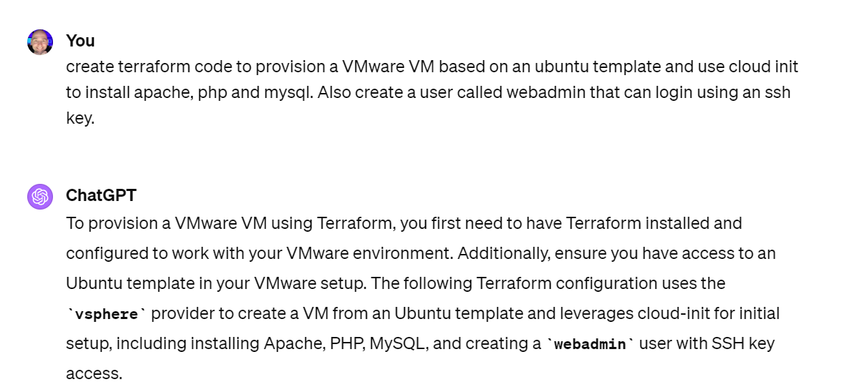
Infrastructure as code RULEZZZ
Infrastructure as code is great because:
Can be managed as code; version control, automated code validation, reviewer, full history, easy roll back, repeatable
Code = language!!
Can use full power of AI / LLM / ChatGPTs

Slide 8
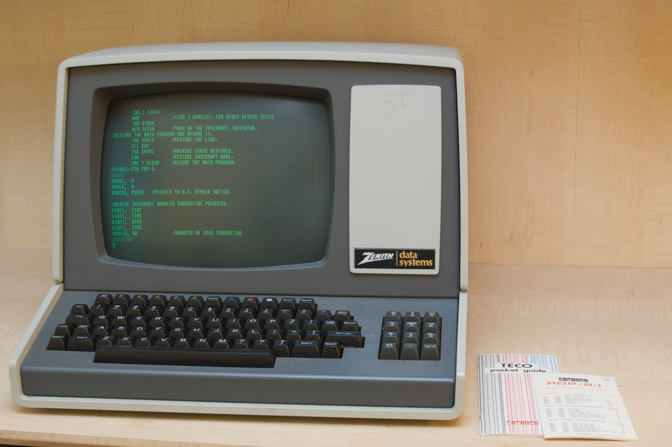

1981-2022: From keyboard to mouse

Slide 9

2023..: mouse to keyboard + LLM

Slide 10
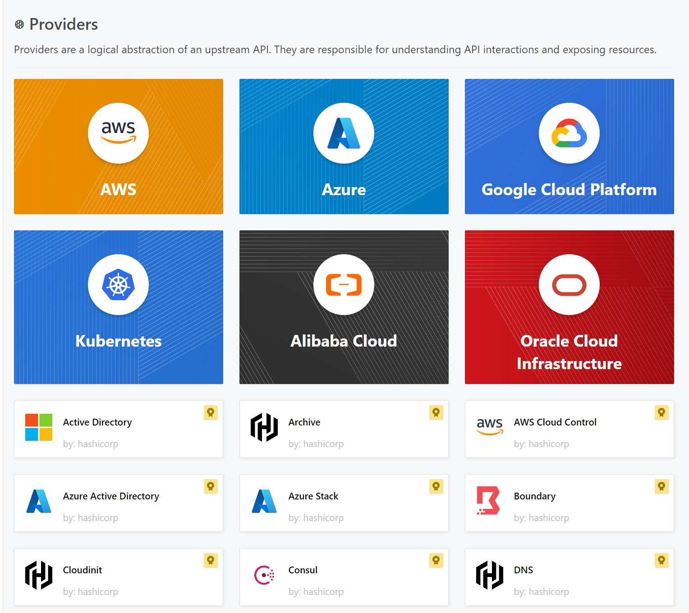
Infrastructure as code RULEZZZ
Infrastructure as code is great because:
Works against almost any platform:
vSphere, NSX, vCloud Director, vRA
Fortigate, Cisco, Commvault, Citrix
AWS, Azure, GCP, Oracle Cloud, Alibaba Cloud…

Slide 11
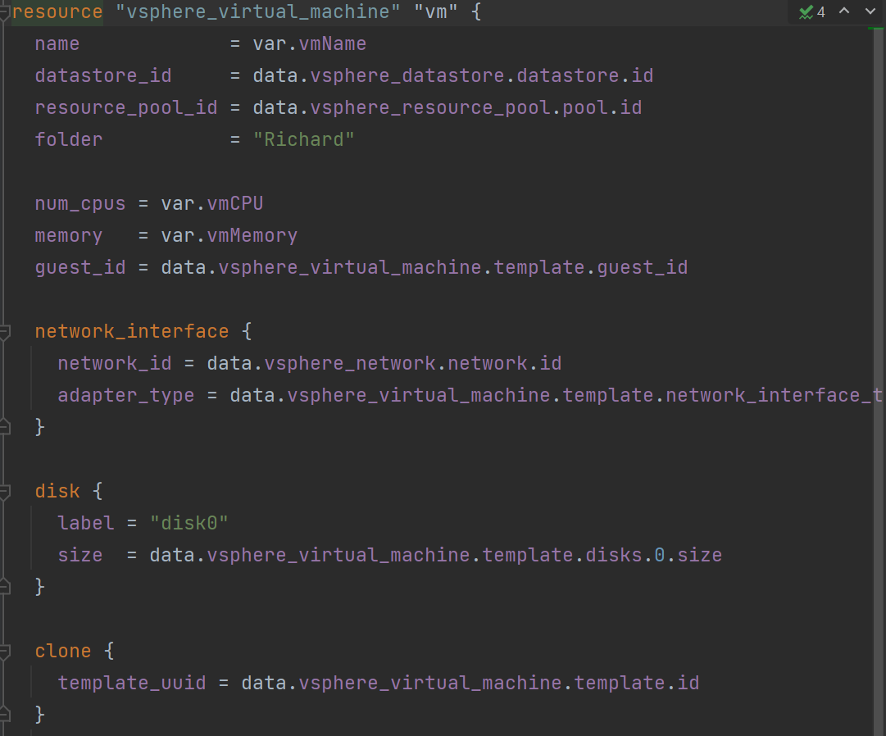
Terraform

Slide 12
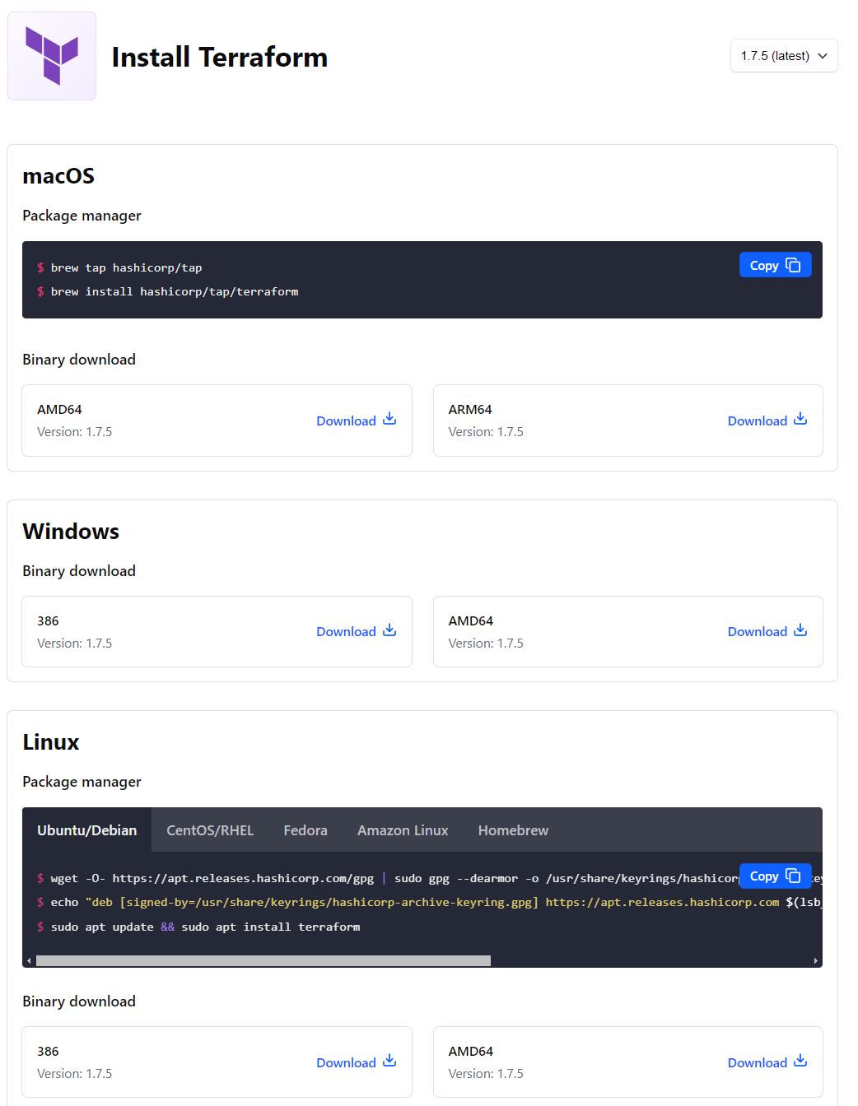
Terraform basics
Simple install, just one executable
https://developer.hashicorp.com/terraform/install

Slide 13
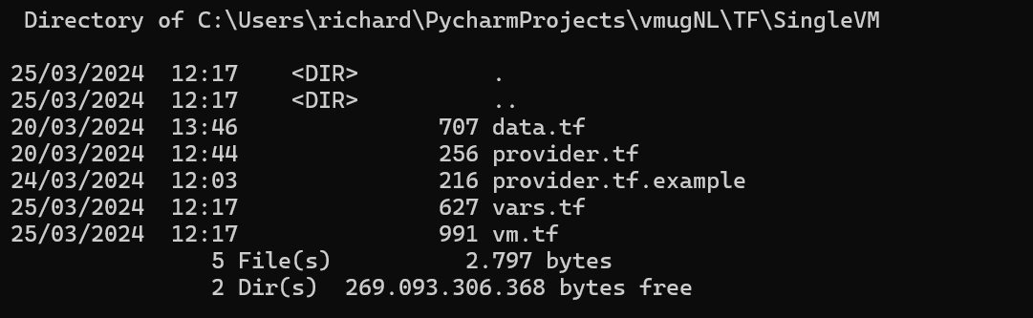
Terraform configuration
All files.tf in one directory are joined automatically
Terraform figures out dependencies and order of execution
For ease of use, easy to organize components using different files

Slide 14
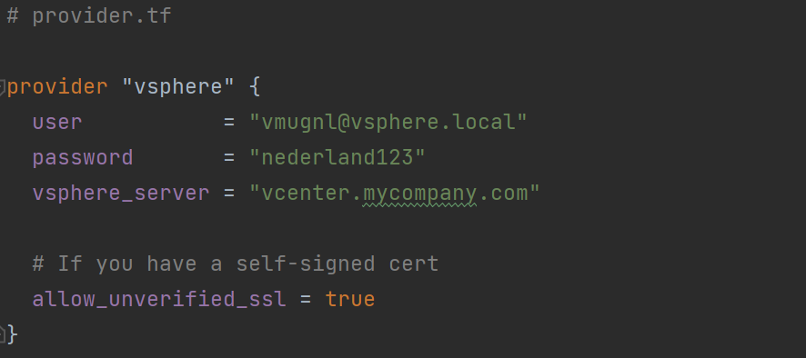
Terraform configuration
provider.tf
Define your connections details
Based on the provider(s) terraform will automatically install all the optional modules to support each provider

Slide 15
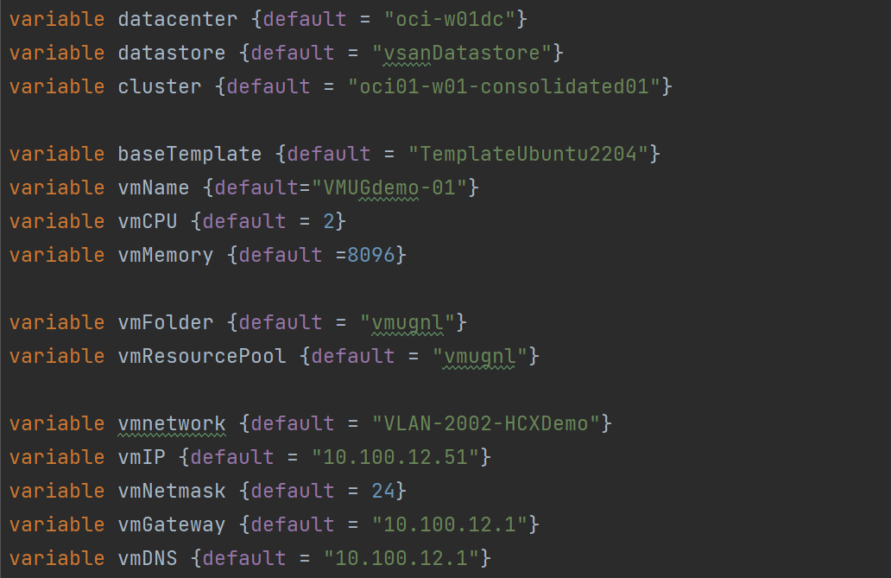
Terraform configuration
vars.tf
Define your variables

Slide 16
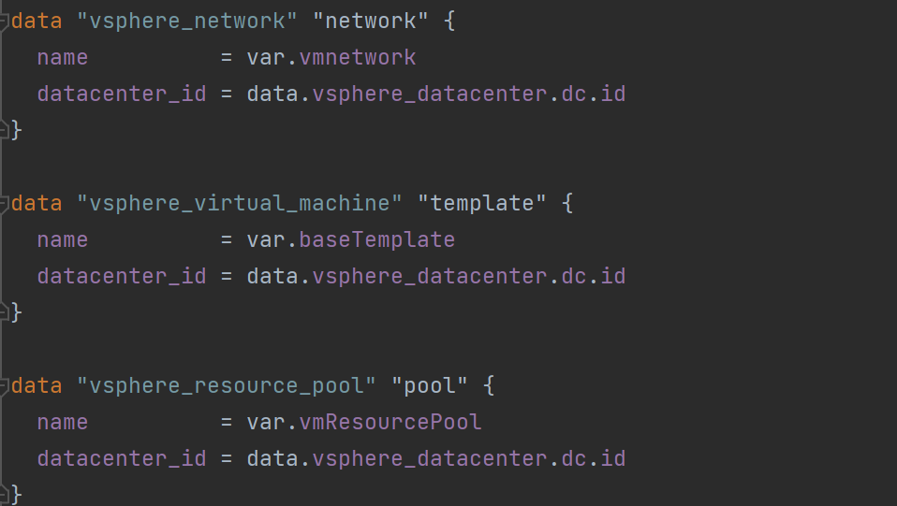
Terraform configuration
data.tf
Query information
When creating resources often identifiers are needed, not friendly names

Slide 17
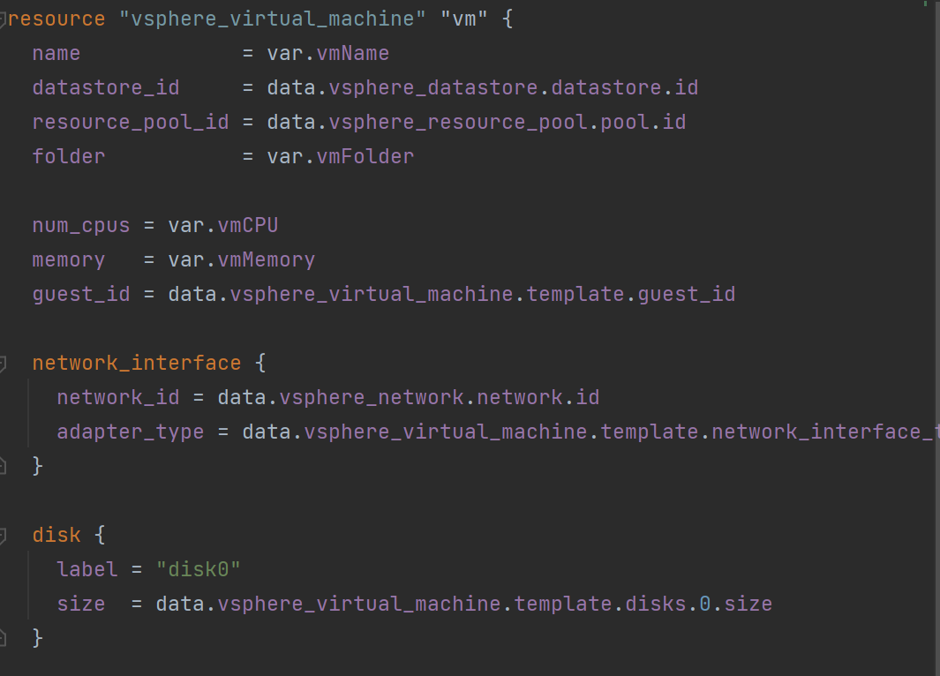
Terraform configuration
resources.tf
Create, update and delete resources

Slide 18
Terraform execution
Running terraform
terraform init
Based on the providers, downloads and install the correct modules
terraform plan
Validates the code and show what will be done
terraform apply
Executes the code. This could mean creating or updating resources
terraform destroy
Rollsback / deletes all the resources

Slide 19
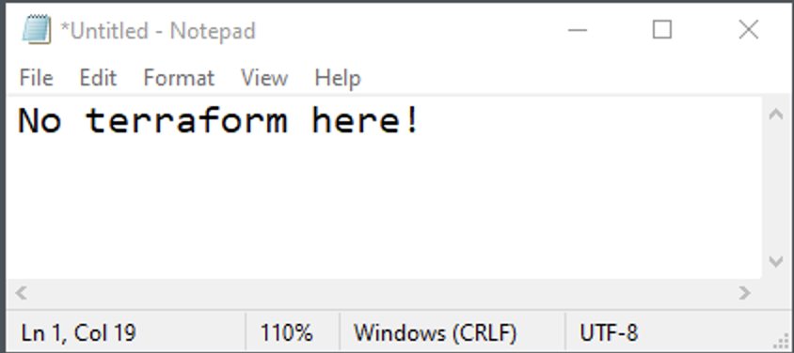
Terraform hint
Do NOT use notepad!

Slide 20
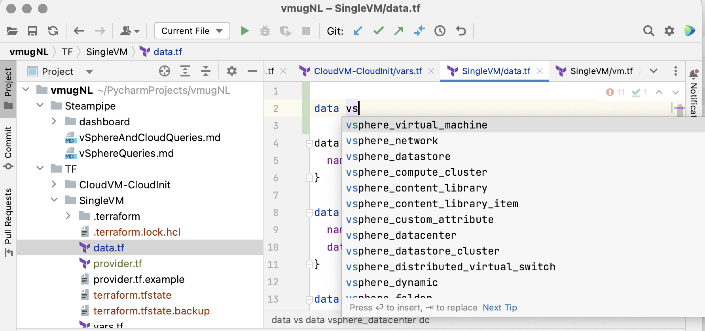
Terraform hint
Use a code editor!
Microsoft Visual Studio
PyCharm
Brainboard

Slide 21
DEMO

Slide 22
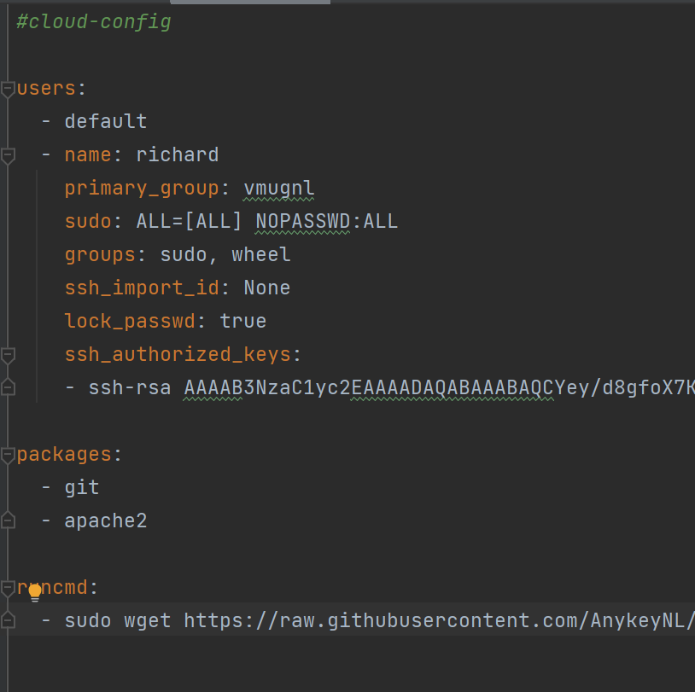
Cloud-init

Slide 23
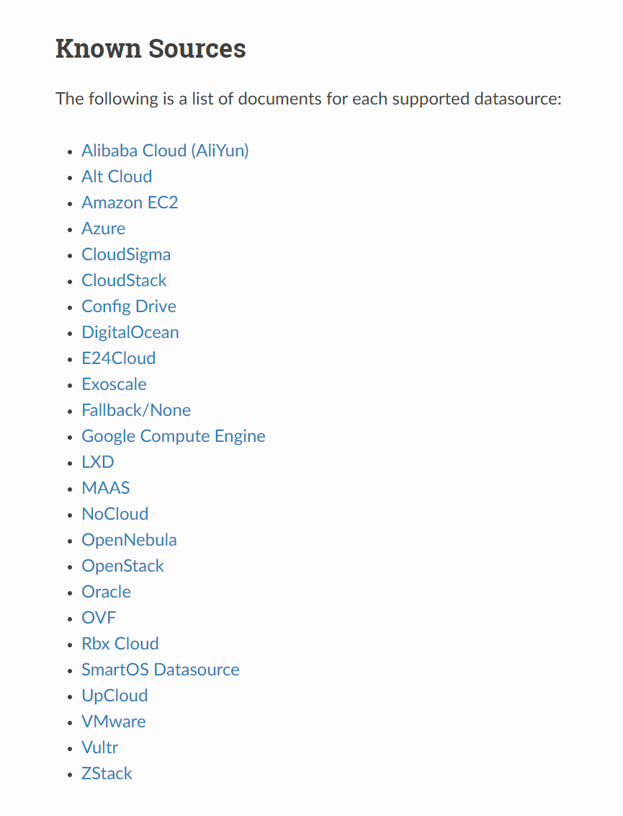
Cloud-init (linux)
Cloud-init is an open-source package that provides an automated process for initializing “cloud” instances during their first boot.
Automatic configuration of a instance with network configuration, disk resizing, and custom scripts, enabling a seamless, script-driven environment setup directly after the instance is provisioned.
Supported by many platforms!
vSphere 7.0 Update 3: the vSphere Guest Operating System (OS) Customization Engine has added native support for using cloud-init!

Slide 24
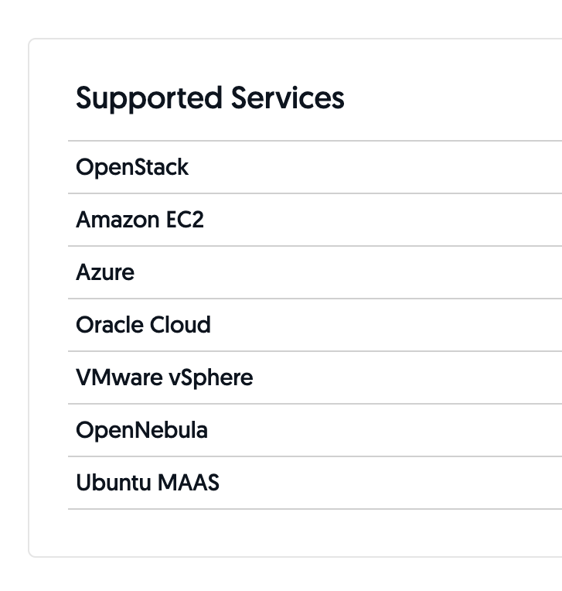
Cloudbase-init (windows)
Cloudbase-init is the Windows equivalent of the Cloud-Init project used on most OpenStack Linux images.
When deployed as a service on Windows, Cloudbase-Init takes care of all the guest initialization actions: disk volume expansion, user creation, password generation, custom PowerShell, CMD and Bash scripts execution, Heat templates, PowerShell remoting setup and much more.

Slide 25
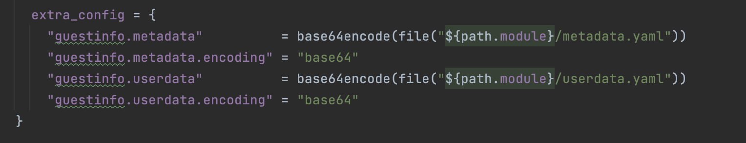
Cloud-init
Metadata:
would include server name, instance id, display name and other cloud specific details.
Userdata:
would include files, YAML, and shell scripts while typical metadata would include server name, instance id, display name and other cloud specific details.

Slide 26
DEMO

Slide 27
Steampipe

Slide 28
Steampipe
select * from cloud;
Dynamically query APIs, code and more with SQL. Zero-ETL from 140 data sources.
select
name,power, num_cpu, memory, ip_address
from
vsphere_vm
https://steampipe.io/

Slide 29
DEMO

Slide 30
Questions?
Today’s Examples and PPT:
https://github.com/AnykeyNL/vmugNL

